Slide 1

ACTING LIKE A DESIGNER
CHAPTER 07
‹#›

Slide 2
Topics
The Iterative Process of Design
Analysis
Design
Implementation
Testing
Iteration!
Innovation
Brainstorming and Ideation
Changing Your Mind
Professional Development Phases
Scoping
‹#›

Slide 3
The Iterative Process of Design
"Game design is 1% inspiration and 99% iteration"
– Chris Swain
‹#›

Slide 4
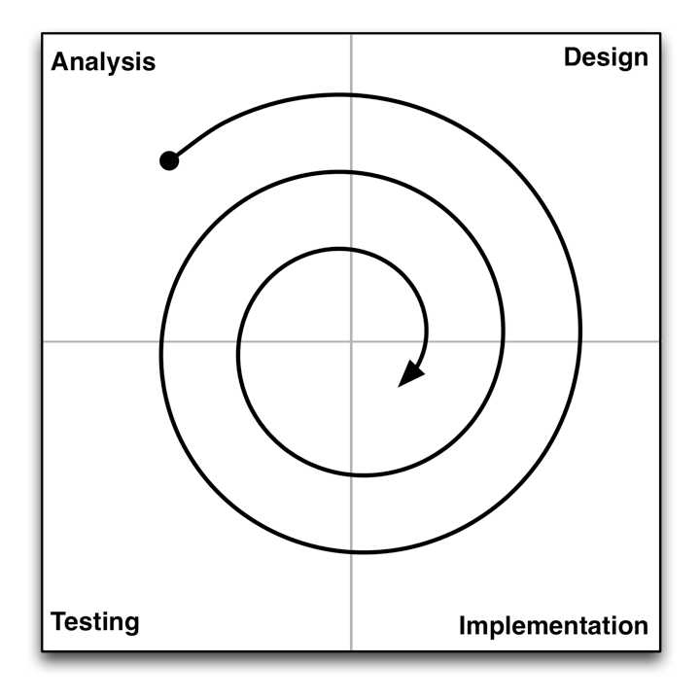
The Iterative Process of Design
Analysis
Understand where you are and what you want to accomplish
Think about your available resources and time
‹#›

Slide 5
The Iterative Process of Design
Design
Create a design that solves the problem or fits the opportunity
Starts with brainstorming. Ends with a plan for implementation.
‹#›

Slide 6
The Iterative Process of Design
Implementation
Execute on your plan. Make a working game prototype.
What is the shortest path to something playable / testable?
‹#›

Slide 7
The Iterative Process of Design
Testing
Have people actually play your game and get reactions!
Testing is critically important to this process!
‹#›

Slide 8
The Iterative Process of Design
Iteration!
Analyze the results of your game testing
Modify your design, implement, test again!
‹#›

Slide 9
The Iterative Process: Analysis
Analysis is about asking the right initial questions
For whom are you designing this game?
Demographic information
Target platform
You're almost never designing the game for yourself!
What are your resources?
Team members, budget, timeline
Time is the most important resource!
What prior art exists?
What other games exist in this space?
This is often ignored by novice designers, but it's critically important!
What is the fastest path to a playable and testable game?
How can you get your game up and running ASAP?
Mechanics are absolutely the most important element in this phase
‹#›

Slide 10
The Iterative Process: Design
A lot of design is about having an attitude of listening
Listen to your audience
Think about your audience when designing a game
Listen to their feedback when you get it
Listen to your team
Listen to the other people who are working with you
Especially when they disagree with you
Listen to your client
If someone is paying you to design a game, you need to listen to them
This often makes them more likely to pay you and hire you again
Listen to your game
Some brilliant ideas just don't fit in the game you're currently designing
Save these for later
‹#›

Slide 11
The Iterative Process: Design
A lot of design is about having an attitude of listening
Listen to yourself
Listen to your gut – Sometimes you'll get a gut feeling about something before you consciously figure it out
Listen to your health – Take care of yourself and stay healthy
Pulling all-nighters and stressing out decreases your creativity
Eat well and exercise
Take breaks when you need to
Listen to how you sound to other people
When you say things out loud, think about how you're coming across
Do you sound respectful?
Do you sound like you care about the other person?
People who demonstrate care and respect for others tend to do better in life, especially in creative fields
‹#›

Slide 12
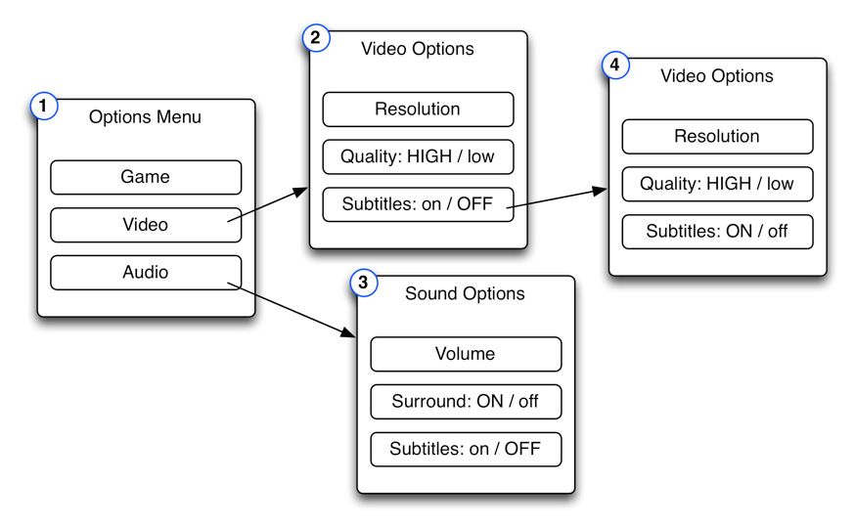
The Iterative Process: Implementation
The goal of implementation is to get from design to testing as quickly and efficiently as possible
Sometimes you don't even have to make a digital prototype
For GUI (Graphical User Interface) testing, sometimes a paper prototype will do just fine
Make pages showing various states of your menu system and test them on people
This is a paper GUI prototype for asking the player how to turn on subtitles
‹#›

Slide 13
The Iterative Process: Implementation
The goal of implementation is to get from design to testing as quickly and efficiently as possible
Sometimes you don't even have to make a digital prototype
When making digital prototypes, focus on the Mechanics
The most important thing to test in a digital game is usually the Mechanics
The Mechanics are also the inscribed element that can't be tested by other means
The Technology of your prototype will often be replaced by production code in the future
‹#›

Slide 14
The Iterative Process: Testing
You won't know anything about your game until someone else plays it
Because you are the designer, your view of the game is drastically biased
You need other people to play the game and give you feedback
People will often try not to hurt your feelings
Schell recommends saying "I need your help. This game has some real problems, but we’re not sure what they are. Please, if there is anything at all you don’t like about this game, it will be a great help to me if you let me know."
‹#›

Slide 15
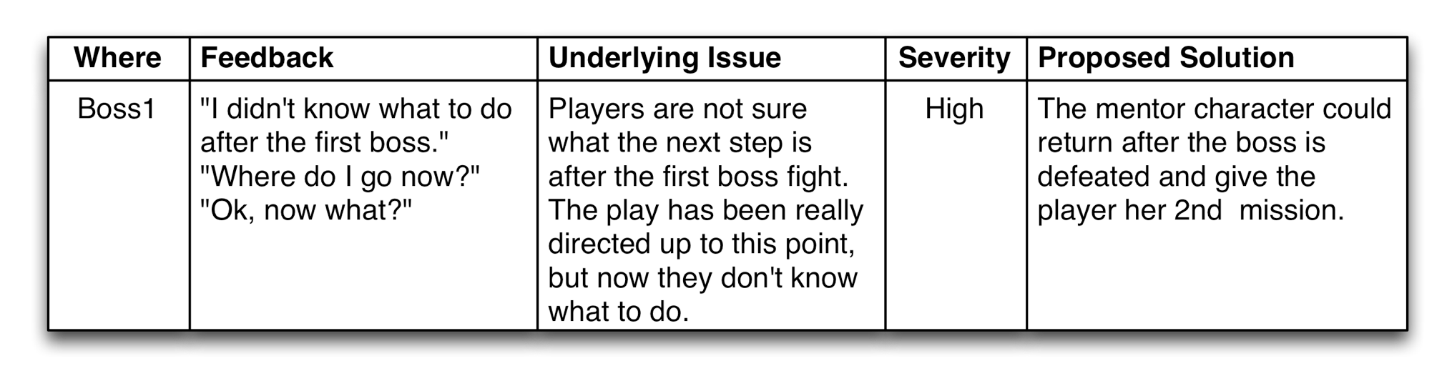
The Iterative Process: Testing
Take good notes!
Where did the comment happen?
What did the playtester actually say?
What do you think she meant?
How severe is the issue?
Not all issues can be fixed
What is your proposed solution?
‹#›

Slide 16
The Iterative Process: Iteration
After testing, analyze the feedback and iterate!
Most games will go through this process many times
Board game projects at USC were four weeks long
Week 1: Students are assigned to teams of four people
Week 2: Students arrive in lab with a playable game
The game is tested by various players for two hours
Week 3: Students bring a 2nd iteration of the game to lab
Week 4: Students bring a 3rd iteration of the game to lab
Then students had a weekend to finalize the game and turn it in
Even for a student board game project, we iterated on the game four times before it was turned in
Digital games take much more iteration!
‹#›

Slide 17
Innovation
In The Medici Effect, Frans Johansson writes about two kinds of innovation:
Incremental - Making something slightly better
Example: The improvements in the Pentium chip in the 1990s
Pros: Easy to convince investors that it will work, Predictable
Cons: Only a slight innovation, Nothing revolutionary, Predictable
Intersectional - The combination of two different ideas
Example: Magic: The Gathering combined card games and collecting
Pros: Has the potential to create something new and exciting
Cons: High chance of failure, People won't believe it 'till they see it
Johansson believes that the innovation in the renaissance was a result of the intersection of Eastern and Western cultures due to increased trade
‹#›

Slide 18
Brainstorming and Ideation
"The best way to have a good idea is to have a lot of ideas and throw out all the bad ones."
– Linus Pauling
Pauling is the only person to have won both the Nobel Prize in Chemistry and the Nobel Peace Prize as an individual.
‹#›

Slide 19
Brainstorming and Ideation
This brainstorming process is based on intersectional innovation
It has worked well in both large and small groups
Five Steps:
Step 1: Expansion
Step 2: Collection
Step 3: Collision
Step 4: Rating
Step 5: Discussion
‹#›

Slide 20
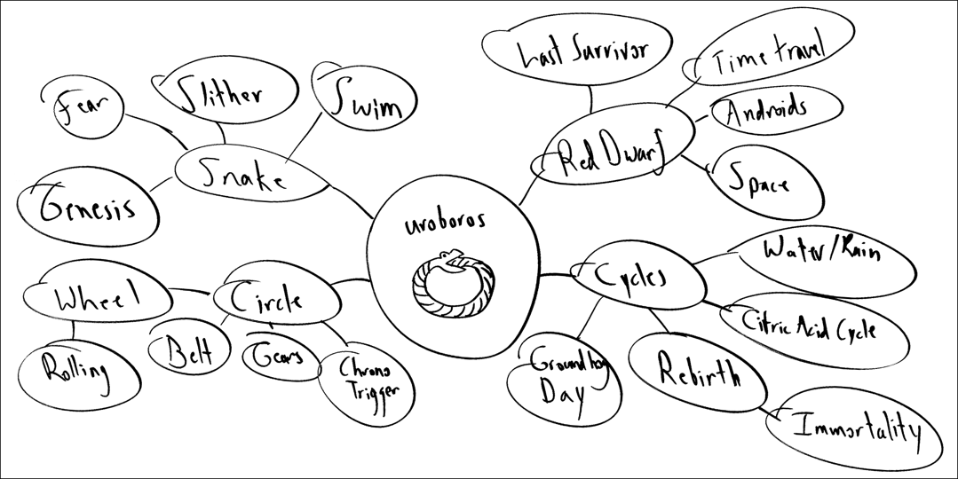
Brainstorming and Ideation
Step 1: Expansion
Start with the core theme of your brainstorm in the middle of a whiteboard
Create as many ideas as possible around it
Don't censor at all in this phase
‹#›

Slide 21
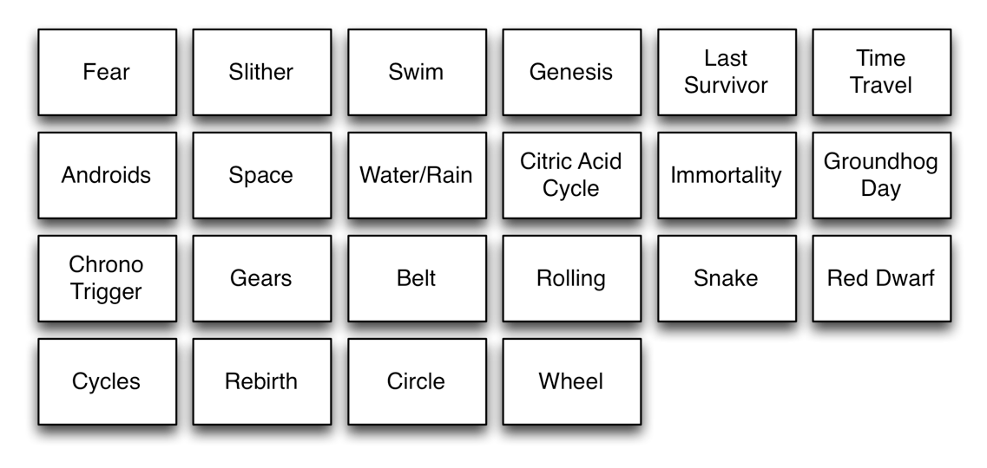
Brainstorming and Ideation
Step 2: Collection
Write down each node of the expansion phase on a 3x5 note card or a Post-it note
These are "idea cards"
‹#›

Slide 22
AN ASIDE ABOUT JOKES
Two lithium atoms are walking along.
One says to the other, "Phil, I think I lost an electron back there."
So Phil says, "Really Jason, are you sure?"
And Jason replies, "Yeah, I'm positive!"
Jokes (even bad jokes) are another form of intersectional innovation
Your brain is thinking in one direction and then is forced to make a connection between that and something unrelated
There is joy in that connection, which we perceive as humor
Creating new, innovative ideas is pleasurable in the same way
‹#›

Slide 23
Brainstorming and Ideation
Step 3: Collision
Shuffle all the idea cards together
Deal two to each person in the group
Each person takes the two idea cards up to the whitboard and reveals them to the group
The group collectively comes up with three game ideas inspired by the collision of the two cards
Again, don't censor too much in this step
‹#›

Slide 24
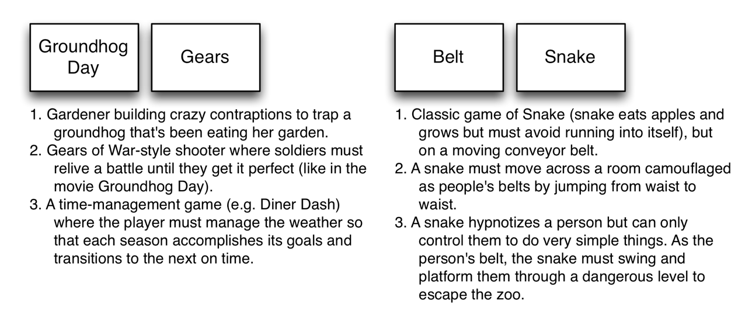
Brainstorming and Ideation
Step 3: Collision
Examples:
‹#›

Slide 25
Brainstorming and Ideation
Step 4: Rating
Each person should pick the two ideas from Step 3 that she feels have the most merit and write them on the whiteboard
If someone has already written one of your top ideas, just write your 3rd choice
Wait for everyone to finish doing this
Then, each person in the group should simultaneously put a mark on the board next to the three ideas that they like the most
Some ideas will have many marks next to them, while others will have only a few
‹#›

Slide 26
Brainstorming and Ideation
Step 5: Discussion
Given the information from Step 4, start discussing ideas
Start with the most popular ideas, but don't be afraid to mix in some of the other ideas as well
Combine the best ideas into something really great!
‹#›

Slide 27
Changing Your Mind
No one every goes directly from idea to game
X
Idea
Game
‹#›

Slide 28
Changing Your Mind
The real process involves a lot of iteration and changing your mind
Prototype
Idea
Prototype
Game
Game
Prototype
Prototype
And you finish with a much better design than your initial game idea!
Game
‹#›

Slide 29
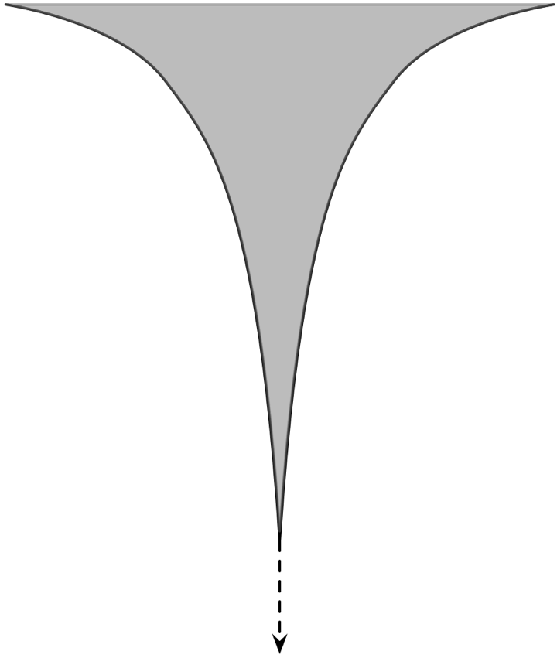
Changing Your Mind
However, as the project moves through development phases, you're more locked in to decisions
Big Changes
Preproduction
Production
Alpha
Beta
Small Changes
Gold
Post-Release
‹#›

Slide 30
Professional Development Phases
Preproduction
Small team (4-16 people)
Lots of prototyping, lots of changes to ideas
Lots of playtesting by a trusted audience
The topic of most of this book
Ends in a high-quality "vertical slice" of the game
Production
Massive team growth (up to 100-300 people)
Systems design needs to be locked down very quickly
Changes cost a lot more, so there are fewer changes
Expands the vertical slice quality to the rest of the game
Playtesting continues (somewhat expanded audience)
‹#›

Slide 31
Professional Development Phases
Alpha
Functionality and game mechanics are 100% locked
No more changes to the systems design of the game
Only make changes in response to specific problems found through testing
Extensive QA (Quality Assurance) testing in this phase by professional QA teams
Some bugs (errors in programming) remain, but all should have been identified
Alpha ends when you believe that all high-level bugs have been resolved
‹#›

Slide 32
Professional Development Phases
Beta
The game is effectively done
Only minor bugs remain
Purpose of this phase is to find and fix any remaining bugs
No design changes, just fixes
Lots of testing!
Gold
The game is ship-ready
Post-Release
In the Internet age, games can have a post-release phase
A little bug-fixing for very rare bugs (encountered by players)
DLC (DownLoadable Content) production
‹#›

Slide 33
Scoping
Overscoping is the #1 killer of game projects.
‹#›

Slide 34
Scoping
Scoping is the process of limiting your design to what can be reasonably accomplished with the time and resources you have available
Most AAA professional games have
Teams of hundreds of people
Budgets of millions of dollars
A two-year development timeline
Think realistically about what you have available when making your games
Look to independent game festivals like IndieCade for inspiration
Even some indie games have large teams and budgets
‹#›

Slide 35
Chapter 7 – Summary
The Iterative Process of Design is the key to good design
Great innovations can come from combining disparate ideas
A good brainstorming process can help you do this
Prototypes exist to help you hone your designs
But you can only make major design changes early in the game development process
Carefully consider the scope of your game design!
Next Chapter:
We explore several goals that you can have as a designer
‹#›

